Slide 1
Cisco Packet Tracer Overview
Presentation_ID
© 2010 Cisco Systems, Inc. All rights reserved.

Slide 2

Agenda
Cisco Packet Tracer Overview
Packet Tracker Key Features
Packet Tracer 5.3
Packet Tracer Key Benefits
Summary
Presentation_ID
© 2010 Cisco Systems, Inc. All rights reserved.

Slide 3

Packet Tracer Overview
Presentation_ID
© 2010 Cisco Systems, Inc. All rights reserved.

Slide 4

What is Cisco Packet Tracer?
▪ Comprehensive networking technology teaching and learning software developed by Cisco Networking Academy
▪ Offers a unique combination of realistic simulation and visualization experiences, complex assessment and activity authoring capabilities, and opportunities for multiuser collaboration and competition
Presentation_ID
© 2010 Cisco Systems, Inc. All rights reserved.

Slide 5



Packet Tracer Simulation-Based Learning
Innovative features help students and teachers collaborate, solve problems, and learn concepts in an engaging and dynamic social environment
Supports lectures, group and individual labs, homework, exams, games, collaborations and competitions
Allows instructors to easily teach and demonstrate complex technical concepts and networking systems design
Helps students develop important 21st century skills
CCNA Overview
© 2009 Cisco Systems, Inc. All righ
ts reserved. Cisco Public
5

Slide 6
Benefits of Simulation-Based Learning
Students who explore and experiment using Packet Tracer develop intellectual curiosity and critical thinking skills.
Packet Tracer’s visually rich simulation environment facilitates
comprehension of complex technology concepts.
Students who troubleshoot networks using Packet Tracer develop
problem solving skills.
Students who design and build virtual networks using Packet Tracer improve their innovation and creativity skills.
Students who explore concepts at their own pace in Packet Tracer’s safe, virtual environment gain confidence in their decision making skills and abilities.
Using Packet Tracer for team collaboration and competition activities builds social, communication, and negotiation skills.
CCNA Overview
© 2009 Cisco Systems, Inc. All rights reserved.
Cisco Public

Slide 7

Packet Tracer Key Features
CCNA Overview
© 2009 Cisco Systems, Inc. All rights reserved.
Cisco Public

Slide 8
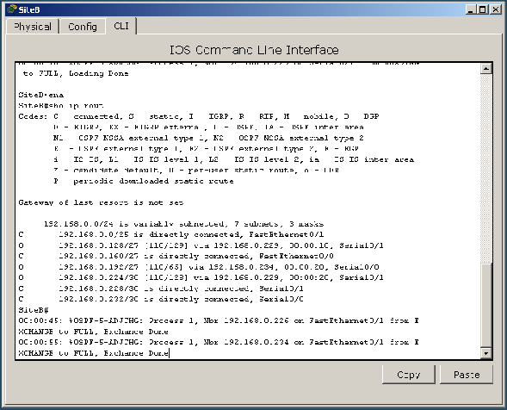
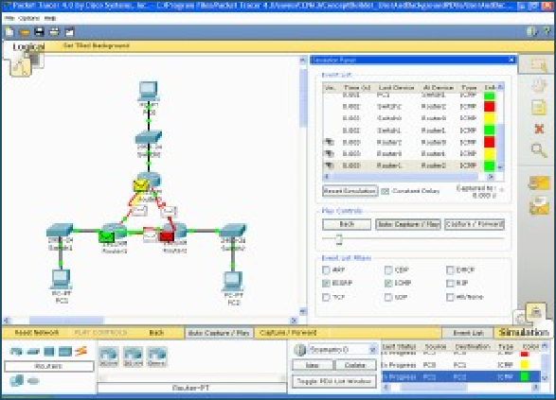
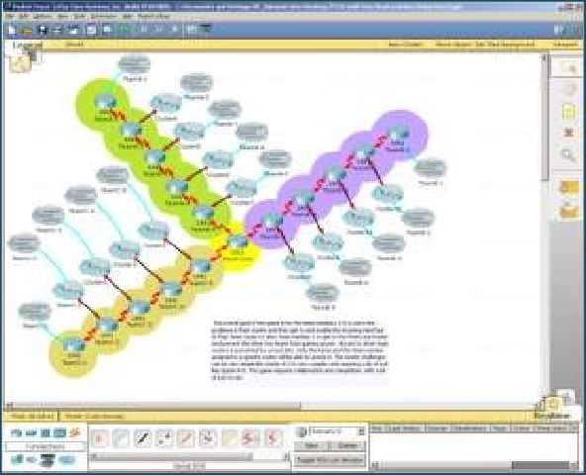


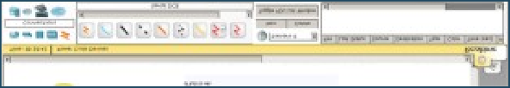
Simulation, Visualization, Collaboration
Simulate IOS Commands
Visualize Network Traffic
Collaborate on Multiuser Activities
CCNA Overview
© 2009 Cisco Systems, Inc. All rights reserved.
Cisco Public

Slide 9
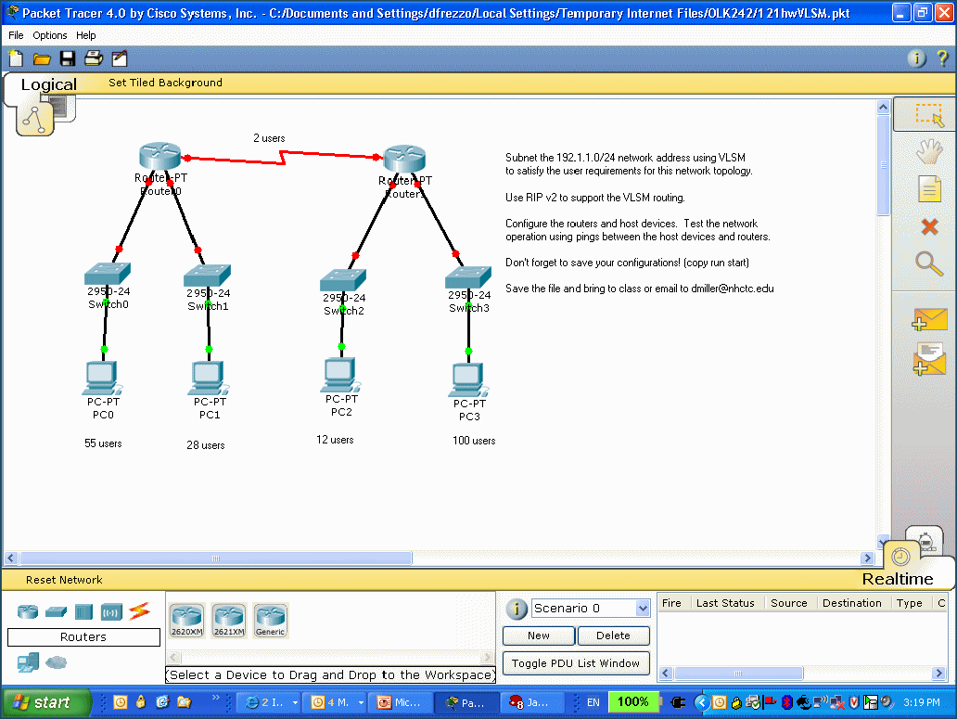
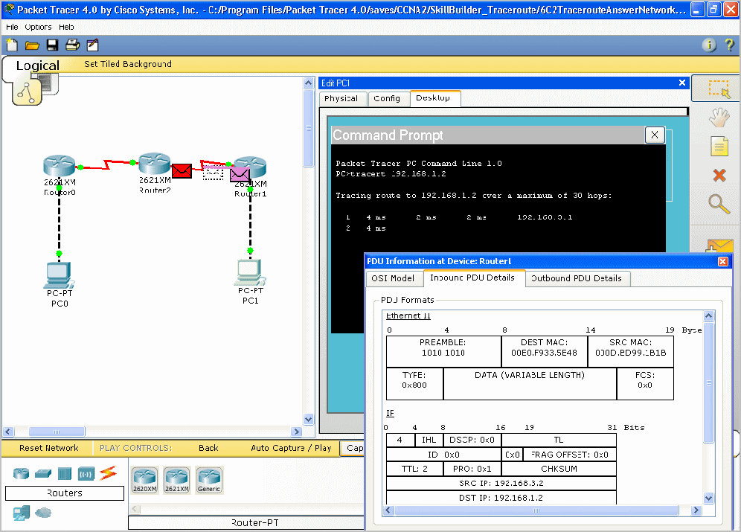
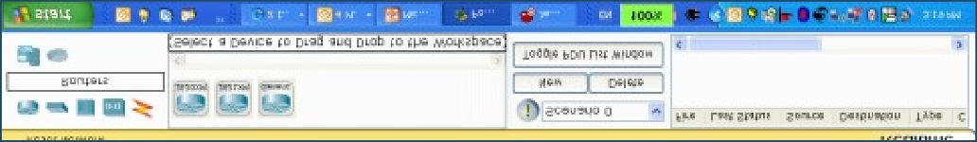

Supports Homework and Pre-Lab Prep
CCNA Overview
© 2009 Cisco Systems, Inc. All rights reserved. Cisco Public

Slide 10
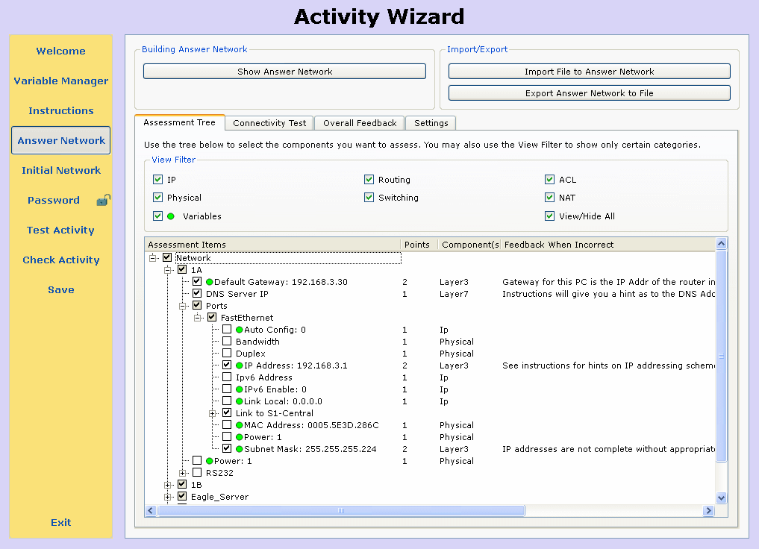
Packet Tracer Activity Wizard
Anyone can author, the PT Activity Wizard guides you
The process is basically write instructions, build a correct answer network, specify grading, specify an initial network, save
Ability to create your own learning activities, tasks, labs, games and complex assessments
Build scaffolded learning experiences, formative and summative assessments
Presentation_ID
© 2010 Cisco Systems, Inc. All rights reserved.

Slide 11
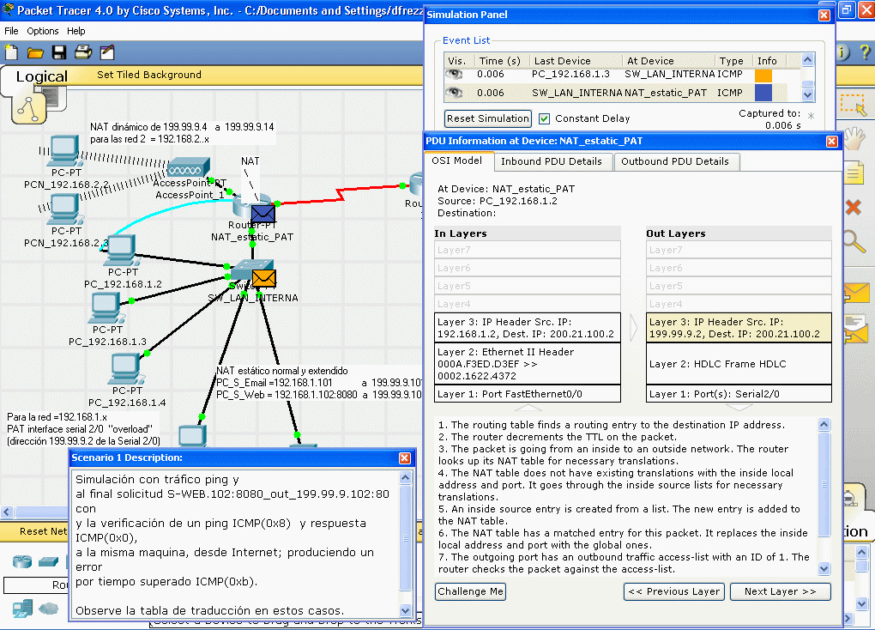
Activity Wizard for Editing PT Activities
Instructors can localize, edit, or enhance existing activities using the Activity Wizard
Presentation_ID
© 2010 Cisco Systems, Inc. All rights reserved.

Slide 12


Packet Tracer Multiuser Functionality
PT is a network-capable (peer to peer) application, using the real network (TCP socket connections) to carry the Packet Tracer virtual packets
The PT application running on one computer can communicate with the PT application running on 1 or more other computers
This connectivity between multiple instances of PT supports teamwork, classroom games, collaboration, competition, remote instructor-student interaction, and social networking
Presentation_ID
© 2010 Cisco Systems, Inc. All rights reserved.

Slide 13
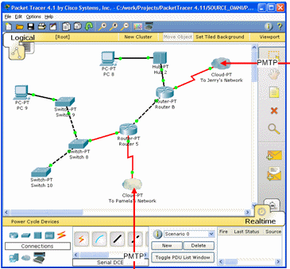
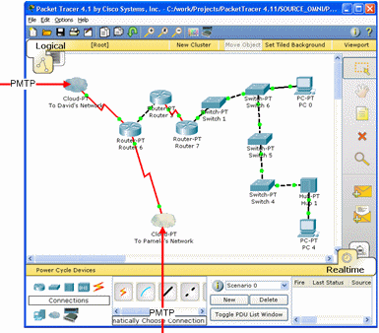
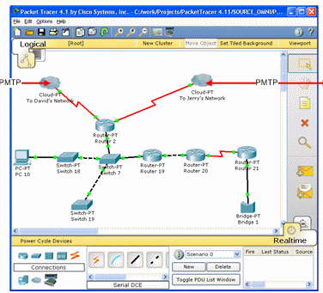
Example Multiuser Scenarios
3 Packet Tracer instances interacting
via Packet Tracer Messaging Protocol (PTMP)
2 teams,
3
1 instructor
different
Real TCP Socket Connection
classes
PC 1
PC 2
Real TCP Socket Connection
Real TCP Socket Connection
3 students
from home
PC 3
Presentation_ID
© 2010 Cisco Systems, Inc. All rights reserved.

Slide 14
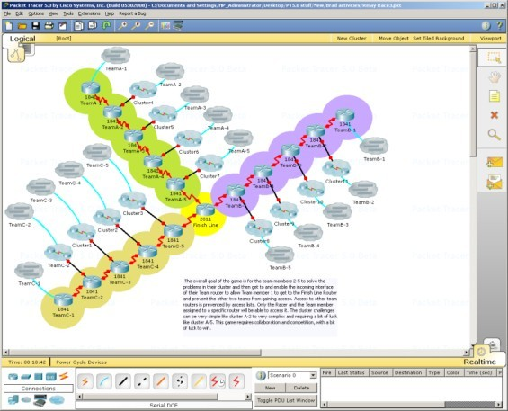
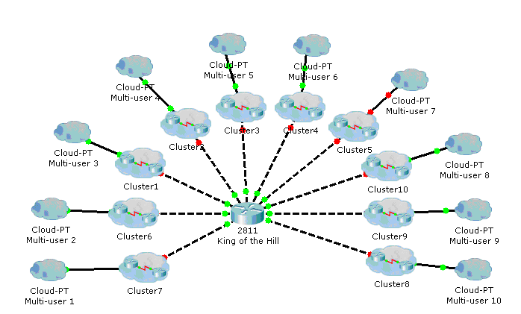
Multiuser Games for Social Learning
Instructor console view of multiuser “Relay Race” game
Instructor console view of multiuser “King of the Hill” game
Presentation_ID
© 2010 Cisco Systems, Inc. All rights reserved.

Slide 15
Packet Tracer Features
Logical and Physical Workspaces
Real-Time and Simulation Modes
User friendly Command Line Interface (CLI)
Global event list (packet sniffer)
LAN, switching, TCP/IP, routing, and WAN protocols
Activity Wizard, Lab grading
Multiuser functionality
Multiple platform support
Multiple language support
Integrated Help and Tutorials
Presentation_ID
© 2010 Cisco Systems, Inc. All rights reserved.

Slide 16
Key E-Learning Component
Learning theories stress early hands-on experiences
Key components of Networking Academy e-learning strategy include
In-person, hands-on labs with real equipment Online curriculum and assessment
Cisco Packet Tracer
Instructor Collaboration Tools
▪ Learning cycles alternating both Packet Tracer activities and in- person, hands-on lab experiences with real equipment are a best practice for teaching CCNA-level networking to beginners
Presentation_ID
© 2010 Cisco Systems, Inc. All rights reserved.

Slide 17
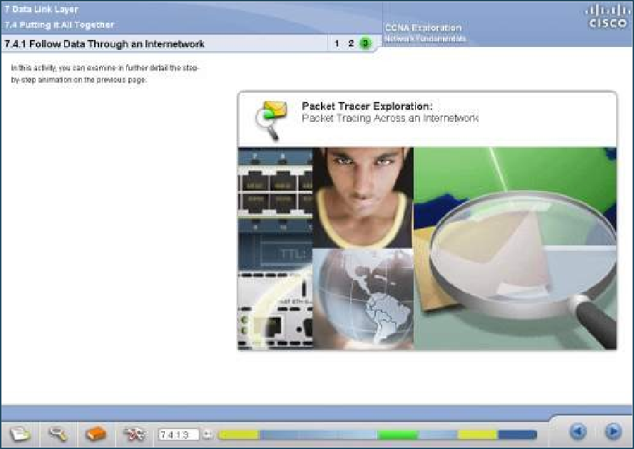
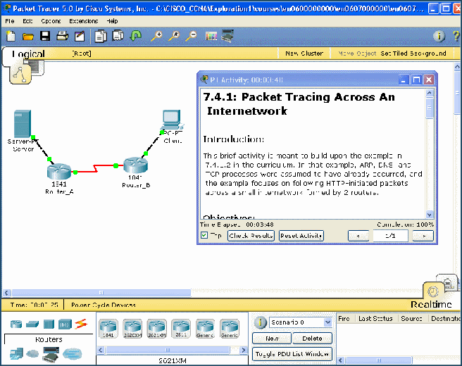


Supports Networking Academy Curricula
▪ Supports the majority of protocols and technologies taught in CCNA Discovery, CCNA Exploration, and CCNA Security, and can also be used to teach concepts from IT Essentials and CCNP courses
Students Launch Packet Tracer Directly From CCNA Discovery and CCNA Exploration to Access Activities That Reinforce the Curriculum
CCNA Overview © 2009 Cisco Systems, Inc. All rights reserved. Cisco Public
17

Slide 18

Packet Tracer Version 5.3
Presentation_ID
© 2010 Cisco Systems, Inc. All rights reserved.

Slide 19
What’s New in Packet Tracer 5.3
Improved Linksys models, wireless security
Cable and DSL enhancements
Call Manager Express (VOIP support)
FTP server and routers/switches - Server and Client
Email system (SMTP – POP3) - Server and Client
BGP – limited implementation that allows for a more realistic representation of the Internet for scenarios
Generic IP end devices – to create more versatility in device creation
Activity Wizard Initial Tree enhancements – more scenario variations
Presentation_ID
© 2010 Cisco Systems, Inc. All rights reserved.

Slide 20
PT 5.3 and CCNA and CCNP Curricula
Version 5.3 enhancements provide new or enhanced functionality to help illustrate the following topics:
▪ CCNA Discovery
D1: improved Linksys and wireless– Generic IP end devices
D2: better DNS, improved DHCP, wireless security, new FTP, SMTP, POP3, D3: Improved multiarea OSPF, EIGRP, BGP
D4: New ISR VOIP, Call Manager Express
▪ CCNA Exploration
E1: improved HTTP, DNS, DHCP, new FTP, SMTP, POP3
E2: Improved multiarea OSPF, EIGRP, new BGP
E3: Improved Linksys models, wireless security, 802.11
E4: New PPPoE, enhanced IPSec, Cable and DSL enhancements
▪ CCNP
Improved multiarea OSPF, EIGRP, new BGP
Presentation_ID
© 2010 Cisco Systems, Inc. All rights reserved.

Slide 21
Packet Tracer 5.3 Protocol Support
▪ Application
FTP , SMTP, POP3, HTTP, TFTP, Telnet, SSH, DNS,
DHCP, NTP, SNMP, AAA,
ISR VOIP, SCCP config and calls ISR command
support, Call Manager Express
Transport
TCP and UDP, TCP Nagle Algorithm & IP
Fragmentation, RTP
Network
BGP, IPv4, ICMP, ARP, IPv6, ICMPv6, IPSec,
RIPv1/v2/ng, Multi-Area OSPF,
EIGRP, Static Routing, Route Redistribution,
Multilayer Switching, L3 QoS, NAT,
CBAL , Zone-based policy firewall and
Intrusion Protection System on the ISR,
GRE VPN, IPSec VPN
▪ Network Access/Interface
Ethernet (802.3), 802.11, HDLC, Frame Relay,
PPP, PPPoE, STP, RSTP, VTP,
DTP, CDP, 802.1q, PAgP, L2 QoS, SLARP, Simple
WEP, WPA, EAP
*New in PT
*Enhanced in PT
5.3
5.3
Presentation_ID
© 2010 Cisco Systems, Inc. All rights reserved.

Slide 22

Packet Tracer Key Benefits
Presentation_ID
© 2010 Cisco Systems, Inc. All rights reserved.

Slide 23
Packet Tracer Benefits
▪ Makes teaching easier by providing a free, multiuser environment for instructors to easily teach complex technical concepts
Makes learning easier by providing a realistic simulation and visualization environment for exploration, experimentation and explanation
Instructors and students can create their own virtual “network worlds” for teaching and learning networking concepts and technologies
Presentation_ID
© 2010 Cisco Systems, Inc. All rights reserved.

Slide 24



Key Instructor Benefits
▪ Ability to teach complex networking concepts
Demonstrate technologies and configurations
Author custom guided activities, labs and assessments with immediate feedback using the Activity Wizard
Use for lecture demonstration, individual and group labs, homework, assessments, games, network design, troubleshooting and modeling tasks, reinforcement of hands-on lab activities, case studies, competitions
▪ Supplements classroom equipment and provides complementary learning opportunities that are not possible in the classroom alone
▪Supports social learning processes via multiuser collaboration and competition
CCNA Overview
© 2009 Cisco Systems, Inc. All rig
hts reserved. Cisco Public
24

Slide 25

Benefits for Students
Provides a free practice and visualization environment for the design, configuration and troubleshooting of network environments
Observe virtual packets real time as they travel through your network
Allows practice outside of the physical classroom and lab (home computers, mobile laptops)
Create and configure much larger topologies than possible with physical equipment available
Provides a rich learning environment beyond standard networking technology instructional practices
Provides valuable hands-on expertise to help you succeed in the classroom and on the job
CCNA Overview
© 2009 Cisco Systems, Inc. All rights reserved.
Cisco Public
25

Slide 26

Summary
Presentation_ID
© 2010 Cisco Systems, Inc. All rights reserved.
Cisco Public
26

Slide 27
Packet Tracer Key Take Aways
Packet Tracer is a powerful network simulation program that allows students to experiment with network behavior and ask “what if” questions
Makes teaching and learning networking technology easier
Not intended to replace experiences with real equipment, but rather to complement them
A laboratory for teaching and learning; you can experiment, you can create your own virtual
network “world”
▪ Helps students develop 21st century skills such as decision making, creative and critical thinking, and problem solving
▪ Packet Tracer is an integral part
Presentation_ID of the Networking© 201A0 Ciscco Sysatems,dInc. Aell rightms reservyed.
27
Cisco Public

Slide 28

Packet Tracer Availability
Packet Tracer is available free to all Networking Academy instructors, students and alumni on Academy Connection
To obtain Packet Tracer
Log in to Academy Connection
Click the Packet Tracer image on the left side of your Home Page
Select the appropriate download option
▪ Recommendation
Download to a local server at your academy and have students install Packet Tracer from the local server
Presentation_ID
© 2010 Cisco Systems, Inc. All rights reserved.
Cisco Public
28

Slide 29
Resources on Academy Connection
FAQs
At A Glance
Datasheet
Overview Presentation
Video viewing link and video downloads
Instructor training materials
Link to Instructor Guides
Release Notes
Supplementary activities for the CCNA curricula
Link to Packet Tracer Trivia game
Link to
Packet Tracer Discussion Forum
And More…See Packet Tracer resource page on Academy Connection
CCNA Overview
© 2009 Cisco Systems, Inc. All rights reserved.
Cisco Public
29

Slide 30
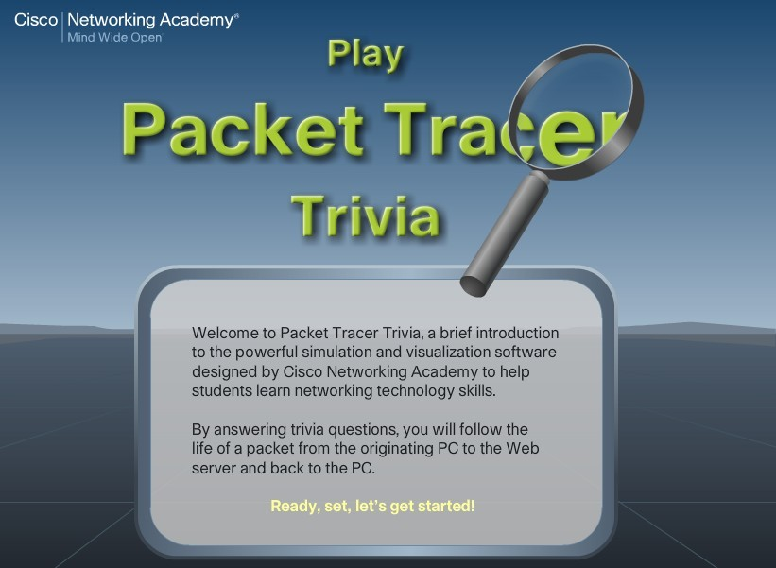
Packet Tracer Trivia
A fun activity that demonstrates how Packet Tracer is transforming student learning and helping to build 21st century skills
Available on www.packettracertrivia.com
Presentation_ID
© 2010 Cisco Systems, Inc. All rights reserved.
Cisco Public
30

Slide 31

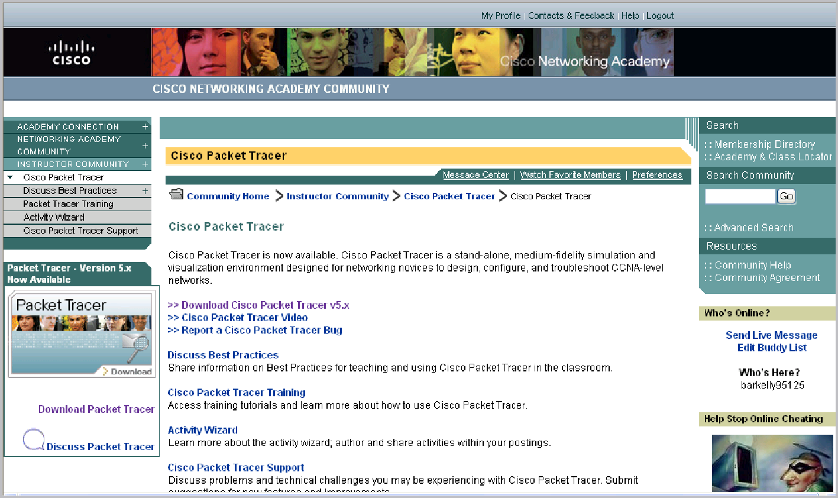
Packet Tracer Discussion Forum
▪ Access the global instructor community for questions, discussions, collaboration, and activity sharing
CCNA Overview
© 2009 Cisco Systems, Inc. All rights reserved.
Cisco Public
31

Slide 32

Presentation_ID
© 2010 Cisco Systems, Inc. All rights reserved.
Cisco Public
32

Slide 33

Presentation_ID
© 2010 Cisco Systems, Inc. All rights reserved.
Cisco Public
33

